Slide 1
TECHNICAL WRITING STRUCTURE

Slide 2
OBJECTIVES
Identify the importance of Information Structures.
Organize information in Technical Communication.

Slide 3
IMPORTANCE: INFORMATION STRUCTURE
Data without structure is not very useful. How do you find what you're looking for? What's important? When you read about a subject, you expect some kind of organization that saves you time and effort in learning. If it is not organized, you will quickly give up. Put the most important information first. What is most important? That depends on your audience analysis.
Generally, warnings come first. Most introductions are a waste of time for the technical reader. They don't read from start to finish, but rather search for a particular chunk of information. So your index, table of contents, or other navigational aids should come first. Assume your readers are intelligent enough to find their way if your organization is clear and consistent.

Slide 4
Descriptions versus Instructions
Structures have descriptions.
Functions have instructions.
When you describe a horse, you list all the components that make up the horse. You may not even need a specific horse in mind, but can define what a horse is in abstract terms. Give your audience the information required to identify a horse.
When you give someone instructions in riding a horse, you should start with a description of the nature of that horse, and how to use the saddle, reins, and stirrups the horse is wearing. Give your audience the information required to take advantage of the horse's function... riding.

Slide 5
Understanding the Role of Description
Technical communication is filled with descriptions – verbal and visual representations of objects, mechanisms, and processes.
Objects: This word covers an enormous range of things from physical sites such as mountains to synthetic artifacts such as hammers.
Mechanisms: It's a synthetic object consisting of a number of moving, identifiable parts that work together as a system. For example, a television set.
Processes: A process is an activity that takes place over time. For example, how plants perform photosynthesis. Furthermore, description of processes differ from instructions, as it explains how something happens where as instruction tells us how to do something. Description of objects, mechanisms and processes appear in virtually every kind of technical communication. Before you begin to write a description, consider carefully how the audience and purpose of the document will affect the way you write it.

Slide 6
The Structure of Object and Mechanism Description
Object and mechanism description have the same basic structure, and the word “item” refers to both object and mechanism. Most descriptions of items have a four – part structure:
1. Title or section heading
2. General introduction that tells the reader the definition of item.
3. Part-by-part description of the item.
4. Conclusion that summarizes the description and explains how the part works together.

Slide 7
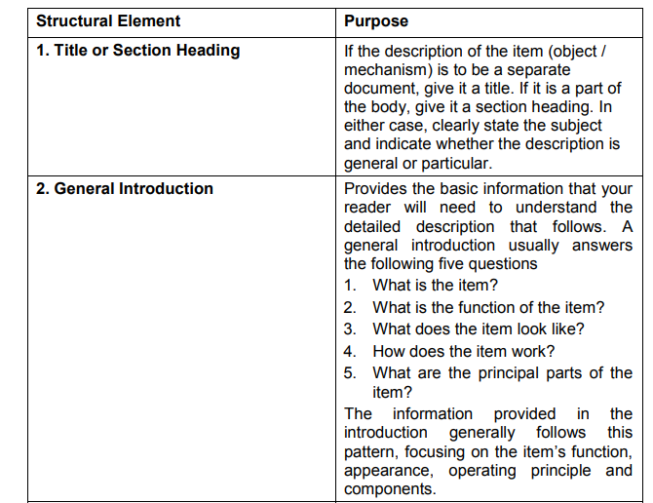

Slide 8
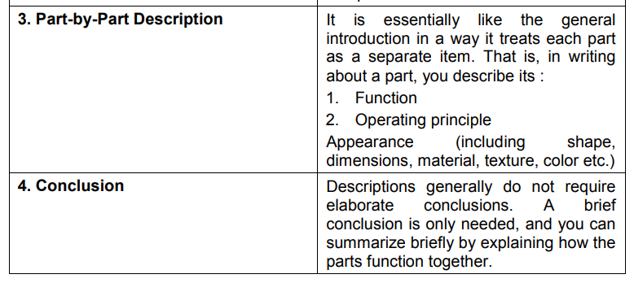

Slide 9
General Description of a Long-Distance Running Shoe
When track and field events became sanctioned sports in the modern world some hundred and fifty years ago, the running shoe was much like any other: a heavy, high-topped leather shoe with a leather or rubber sole. In the last two decades, however, advances in technology have combined with increased competition among manufacturers to create long-distance running shoes that fulfill the two goals of all runners: decreased injuries and increased speed. Introduction This paper is a generalized description of a modern, high-tech shoe for long-distance running. The modern distance running shoe has five major components:
• the outsole • the heel wedge • the midsole • the insole • the shell

Slide 10
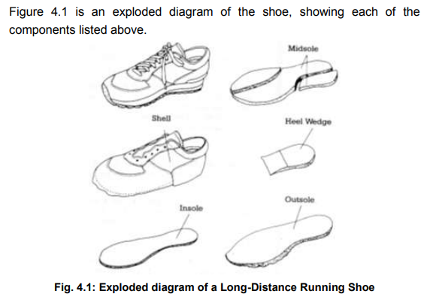

Slide 11
The Components:
In the following sections, the five principal components of the shoe are discussed from bottom to top. The Outsole The outsole is made of a lightweight, rubber like synthetic material. Its principal function is to absorb the runner's energy safely as the foot lands on the surface. As the runner's foot approaches the surface, it spinets – rolls outward. As the foot lands, it pronates – rolls inward. Through tread design and increased stiffness on the inner side, the outsole helps reduce inward rolling. Inward rolling is a major cause of foot, knee, and tendon injuries because of the magnitude of the force generated during running. The force on the foot as it touches the running surface can be upto three times the runner's weight. And the acceleration transmitted to the leg can be 10 times the force of gravity.

Slide 12
The Heel Wedge
The heel wedge is a flexible platform that absorbs shock. Its purpose is to prevent injury to the Achilles tendon. Like the outsole, it is constructed of increasingly stiff materials on the inner side to reduce foot rolling.
The Insole
The insole, on which the runner's foot rests, is another layer of shock absorbing material. Its principal function, however, is to provide an arch support, a relatively new feature in running shoes.

Slide 13
The Midsole
The midsole is made of expanded foam. Like the outsole and the heel wedge, it reduces foot rolling. But it also is the most important component in absorbing shock. From the runners point of view, running efficiency and shock absorption are at odds. The safest shoe would have a midsole of thick padding that would crush uniformly as the foot hits the running surface. A constant rate of deceleration would ensure the best shock absorption. However, absorbing all the shock would mean absorbing all the energy. As a result, the runner's next stride would require more energy.

Slide 14
The Shell
The shell is made of leather and synthetic materials such as nylon. It holds the soles on the runner's foot and provides ventilation. The shell accounts for about one-third of the nine ounces a modern shoe weighs.
Conclusion
Today, scientific research on the way people run has led to great improvements in the design and manufacture of different kinds of running shoes. The results are a lightweight, shock-absorbing running shoe that balances the needs of safety and increased speed.

Slide 15
The Structure of Process Description
The structure of the process description is essentially similar to that of the object or mechanism description. The only significant difference is that the process is segmented into a reasonable (usually chronological) sequence of steps rather than parts. Most descriptions of items have a four–part structure:
1. Title or section heading
2. General introduction that tells the reader what the process is and what it is used for
3. Step-by-Step description of the process
4. Conclusion that summarizes the description and explains how the steps works together

Slide 16
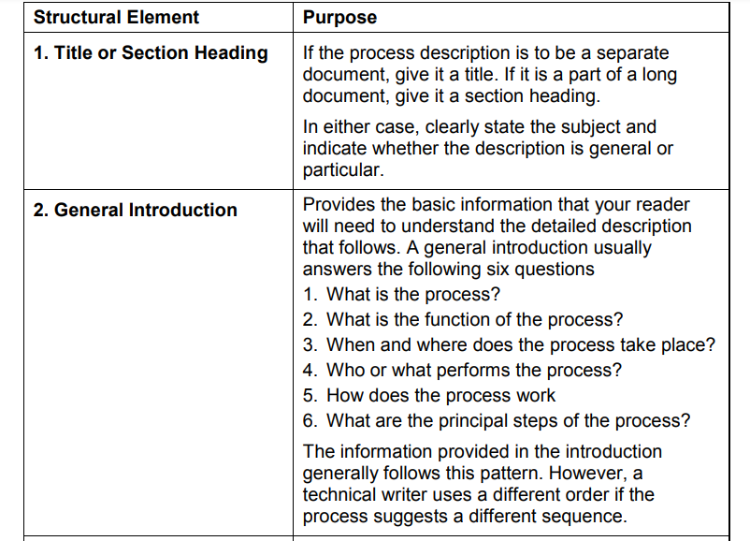
Process Description

Slide 17
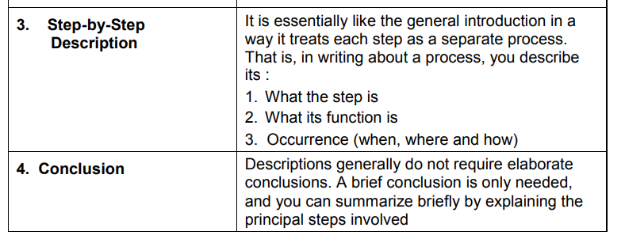

Slide 18
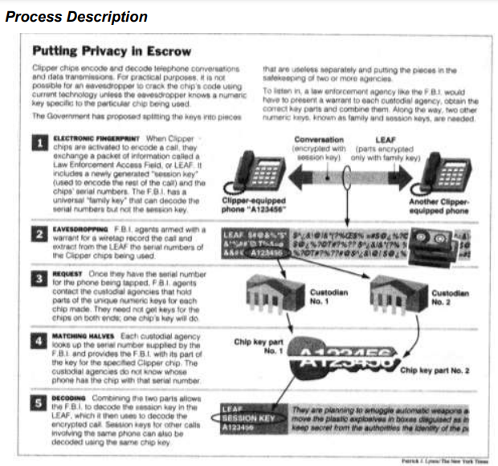

Slide 19
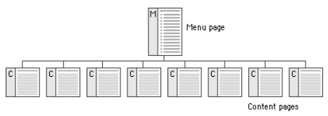
Hierarchical Structure

Slide 20
Horizontal organization
Horizontal organization emphasizes the dependencies within the process.
One thing follows another.
At the same time, it shows that you may start the process at a variety of points. Anything can be first. There are many ways to achieve the users' goals

Slide 21
Vertical structures
Vertical structures, where there is only one path to follow, are rare.
A single information chunk in the form of an instruction may be presented as a vertical structure

Slide 22
linear structure
A linear structure is familiar to everyone who reads books. There is a beginning, middle, and an end. For something to happen, something else must happen first. It depends, or has a “dependency” on the first action.

Slide 23
Non-linear structure
Online structures, as you quickly learn by surfing the internet, are non-linear.

Slide 24
Structural Clash
Most systems have a mix of dependent and non-dependent functions. Where there are dependencies, a numbered hierarchical structure for the user information is obvious. Where the functions are non-dependent, a nonlinear or horizontal structure makes more sense. But on paper, you cannot effectively represent a non-linear structure. So you must arbitrarily (randomly) assign importance to various features. In each case, the key is good navigation designed with your audience in mind, with both structure and function. Allow your readers to search for the information they want with an online search function. Printed documents can have tables of contents and indexes.

